Slide 1
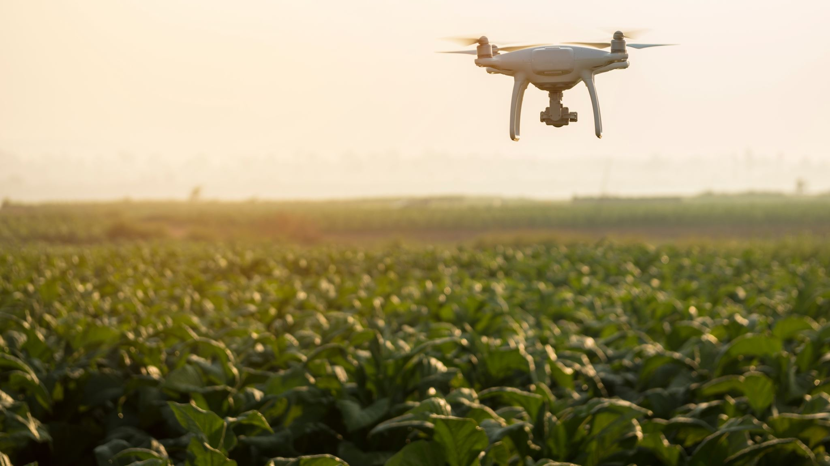


Drone Obstacle Avoidance MSBA Silicon Valley Cohort Landon Smith March 15th, 2023
X

Slide 2
Foreword
Thank you to Brian and Nelson from NASA for your insights! Thank you to Professor Navid and Professor Zahra for your support! Your assistance helped this project thrive!

Slide 3

Agenda
Project Goal
Benefits of Using Bayesian Analysis
Methodology
Tech Stack
Potential Future Work

Slide 4
Project Goal – Achieve A Probabilistic Determination of Height Values
Through implementing a Bayesian Regression Model on cross-validated, overlapping LIDAR point cloud data, we can construct a probabilistic determination of whether an obstacle exists in a specific location rather than a simplistic binary assumption
This can be done by first creating a "cell" for every potential geographical location an obstacle could be situated
The sizing of these cells would change based on the desired accuracy of the prediction model
For example, we could allow the the size of the cells to be relatively large in rural areas where obstacles are extremely sparse, but constrict the size of the cells in urban areas where the risk of an obstacle collision is much higher due to the higher density of obstacles
We will let each cell be represented by a normal probability distribution, where the mean is the height of the obstacle, and the standard deviation is our confidence about the height of the obstacle

Slide 5
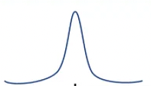

Benefits of Using Probabilistic Determination of Height Values for Drone Obstacle Avoidance
The use of Bayesian Regression Analysis to generate probability distributions for each cell allows path planning algorithms to utilize much more information than a binary representation of obstacles would enable
For example, instead of only being able to ask whether there is an obstacle present in a certain location at a height of 10 feet, we can ask what the probability is that there is an obstacle in that certain location at a height of ten feet
Start
 |  | Finish

Slide 6
Benefits of Using Probabilistic Determination of Height Values for Drone Obstacle Avoidance
This probabilistic dimension of the data enables path planning algorithms to adjust their flight paths more precisely to the needs of the mission by evaluating the cumulative likelihood of success of each potential flight path
For example, if the drone operator wishes to adopt a conservative approach to obstacle avoidance, they will have a higher threshold for the cumulative probability of cell's containing an obstacle
This could result in cells without obstacles in them being avoided, making the desired path a longer distance to traverse but safer
However, if a drone operator decides to utilize a risk-tolerant approach, they will have a lower threshold for the cumulative probability of cell's containing an obstacle
This could cause some obstacles to be overlooked and potentially cause the drone to collide with obstacles on its flight path, but this risk would likely be offset by a decrease in flight duration
The appropriate cumulative probability threshold to go with ultimately depends on the characteristics of the mission

Slide 7
Outline of Methodology
Step 1: Take the x, y, and z values from geographically overlapping raw LIDAR datasets
Step 2: Letting each unique longitude & latitude combination serve as a cell on a grid representing the landscape, compare the height values reported within each dataset
Step 3: Feed the cross-validated height values into a Bayesian Regression model in order to add a probabilistic dimension to the data
Step 4: Use the output of the Bayesian Regression model to determine what cells contain obstacles according to a user-defined drone flight height and acceptable probability threshold
Step 5: Insert the output of the Bayesian Regression model to a database where the results can be queried by those seeking to use the data for proprietary flight path planning algorithms

Slide 8
LIDAR Data Source – OpenTopography
OpenTopography is a website which facilitates access to “high-resolution, Earth science-oriented topography data and related tools and resources.”
As a proof of concept, the point cloud data utilized in this obstacle avoidance project is sourced from overlapping LIDAR scans of a sample plot of land located in Emeryville, California with the following geographical bounding box:
minX, minY (-13614349.164060349, 4557303.475503025)
maxX, maxY (-13613408.779604943, 4558076.336715533)

Slide 9
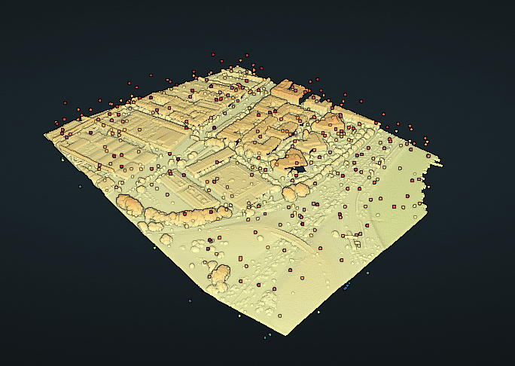
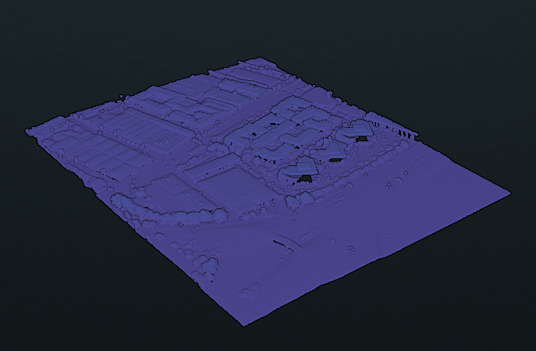
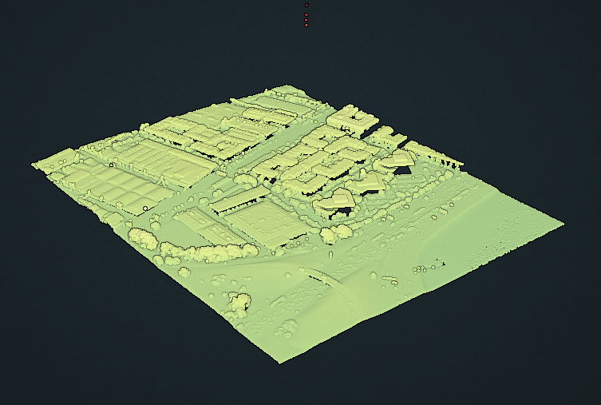
Point Cloud Visualizations of Overlapping Datasets
CA AlamedaCo 2 2021
15,662,860 rows
ARRA-CA SanFranCoast 2010
1,106,848 rows
USGS LPC CA NoCAL Wildfires B5b 2018
1,355,242 rows

Slide 10
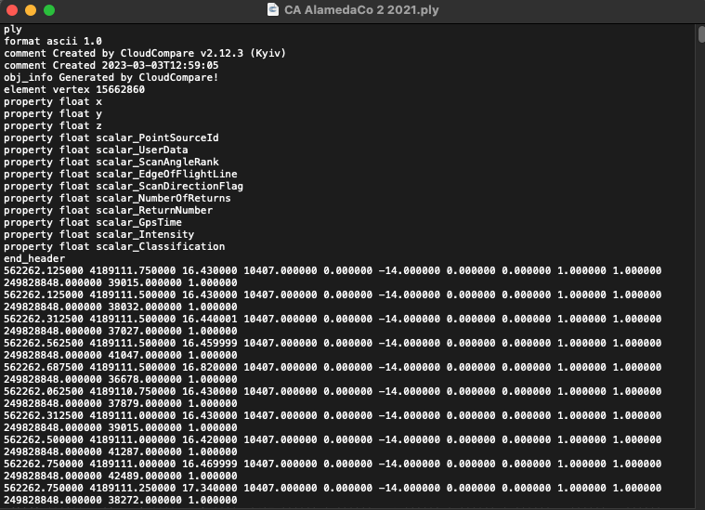
Data Cleaning: Scrape LIDAR Coordinates
CA AlamedaCo 2 2021.ply
Created a Python script to extract only the x, y, and z values of each row
These values are extremely precise
Rounded these values to the nearest integer to be repurposed as cells on a grid and make cross-validation of z values across other two datasets easier

Slide 11
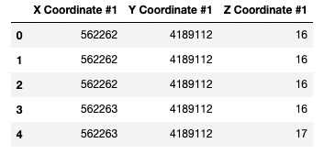
Drop Duplicate Rows from the Data
Rounding created duplicate rows displaying redundant information
These duplicates were dropped from the table, reducing its size from 15,662,860 rows to 800,704 rows

Slide 12
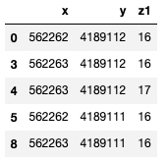
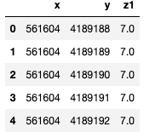

Taking Average and Dropping Duplicate Rows Again
Dropping all of the duplicate rows where we had redundant x and y values didn’t remove all duplicates because certain rows contained different reported z values (some were rounded up & some were rounded down)
Taking the average of the rows with the same x and y gave us a table of fully unique x and y value combinations that will be utilized as cells later on

Slide 13
Final Row Counts for Each Dataset
CA AlamedaCo 2 2021
438,486 rows
ARRA-CA SanFranCoast 2010
420,973 rows
USGS LPC CA NoCAL Wildfires B5b 2018
430,855 rows

Slide 14
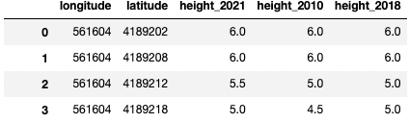
Merge 2021, 2018, and 2010 LIDAR Datasets Together
Merging the x, y, and z values for all 3 LIDAR datasets together results in a table with 452,788 rows
This value is greater than any of the individual tables because certain tables had unique x and y combinations that were not reflected in the other datasets

Slide 15
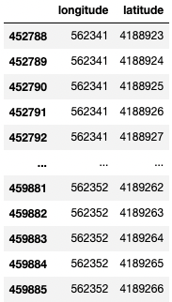
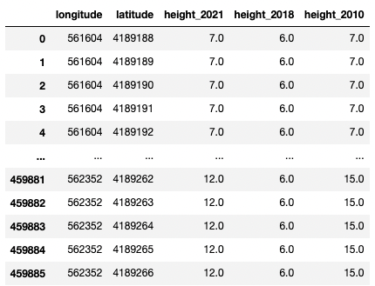
Add Cells Not Represented and Interpolate
Using our minimum and maximum x and y values, we know our total grid should be 749 meters x 614 meters
459,886 total cells
This means we have 7,098 rows not represented that need to be to be present to ensure grid continuity for an obstacle avoidance use case
About 1.54% of the dataset
These rows were added to the dataset and an interpolation technique was used to replace null values and create our finished dataset

Slide 16

Bayesian Analysis
Import our interpolated table from Python into R
Create a Bayesian Regression Model
Use height_2021 as Dependent Variable
Use height_2018 & height _2010 as Independent Variables
Ensure our model has converged before checking results

Slide 17
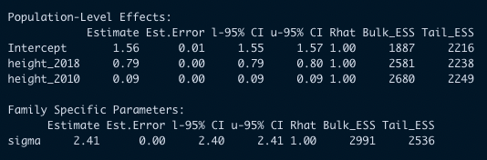
Bayesian Analysis – Convergence
We know our model has converged by observing that the Rhat values are 1
We can also view the values for the intercept, height_2018, and height height_2010
Despite our usage of Bayesian Analysis being for the addition of a probabilistic dimension to the data and not for prediction purposes, we can see that 2021 is much more similar to 2018 than 2010

Slide 18
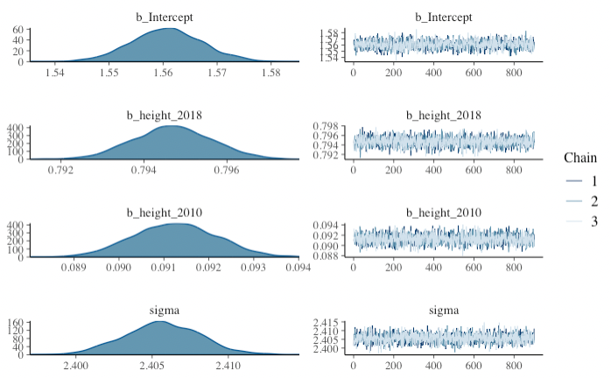
Bayesian Analysis - Convergence
The second criteria required to confirm the convergence of our model is also acceptable
The fuzziness of the charts to the right implies proper convergence

Slide 19
Bayesian Analysis – Definition of Thresholds
Define obstacle height threshold
Any cell with a height over this threshold will be defined as an obstacle
The obstacle height threshold used in this example is 10 meters
Define acceptable probability threshold
Creates a threshold for the probability that there is an obstacle of a certain height situated in the cell
A value of 0.20 here would mean that if there is a 20% chance there is an obstacle 10 meters tall in the cell, we should count it as an obstacle

Slide 20
Obstacle Detection – Individual Cell Posterior Probability Compared to Acceptable Probability
For each cell on the map, we now calculate the posterior probability of its height
Now that we have the posterior distribution of 2021 heights for each square available, we can calculate the probability of a cell's height exceeding our defined obstacle_height
This is the same as computing the likelihood of an obstacle being present the cell
Next, we must check if the probability of an obstacle being present in the cell is more than the acceptable probability that we defined earlier
If the height probability ends up being greater than the acceptable probably, it will be defined as an obstacle, denoted by 1.
The inverse will occur if the opposite is true
For this example, this methodology returns 166,946 cells with obstacles out of the 459,886 total cells our grid contains

Slide 21
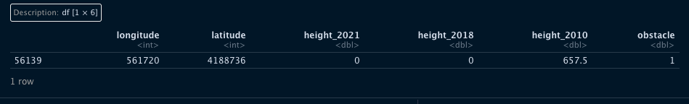
Probabilistic Determination of Height - Proof of Concept
The value in the height_2010 column reflects an obvious outlier that should be scrubbed from the dataset
While an exaggeration, this row is displayed as a proof of concept for the probabilistic determination of height rather than strictly binary
Instead of only using the 2021 dataset due to recency bias and concluding there is no obstacle, we conclude there is an obstacle due to the value of 657.5 bring the probability there is an obstacle over 10 feet to over 20%, despite both the zero values in the height_2021 and height_2018 columns

Slide 22
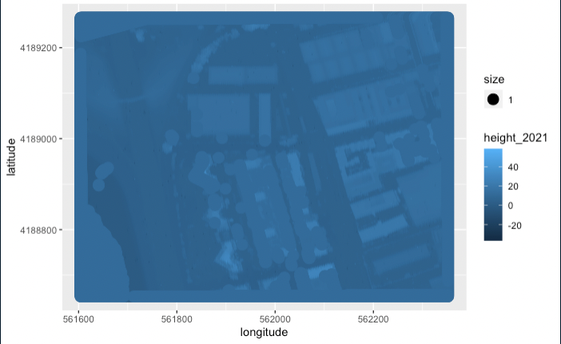
Visualization of Our Grid
R is able to create a visualization of the expected heights for each cell on our grid
We can observe buildings, trees, and a bridge according to the color-coded legend

Slide 23
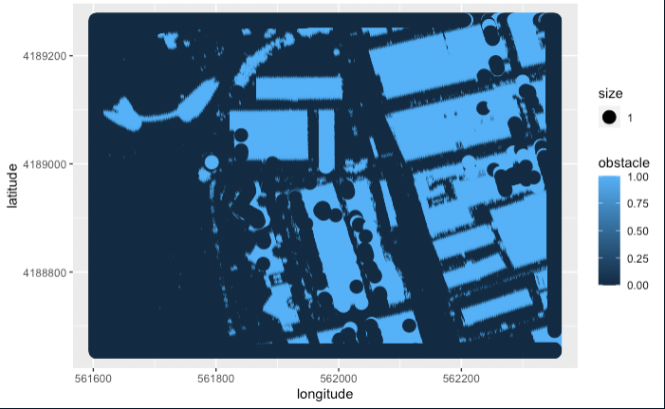
Visualization of Obstacles
After viewing our grid of expected height values, we can then plot the cells where the obstacle value is equal to 1 on our grid
This visualization represents all cells with at least a 20% probability of containing an obstacle 10 meters in height

Slide 24
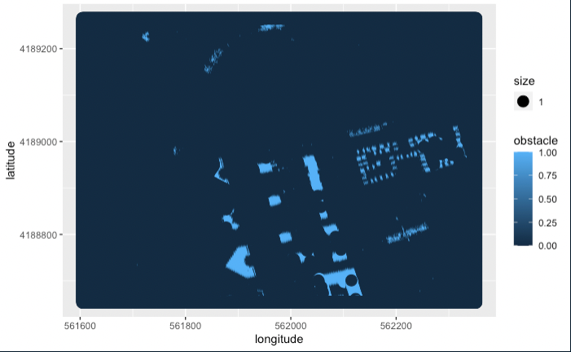
Visualization of Obstacles
As a proof of concept, adjusting the obstacle height threshold to 20 meters with an acceptable probability threshold of 20% greatly reduces the number of obstacles identified as observed to the right
At the typical flight height of a drone at 30 meters, there are virtually no obstacles, allowing a drone to fly over this plot of land unimpeded

Slide 25
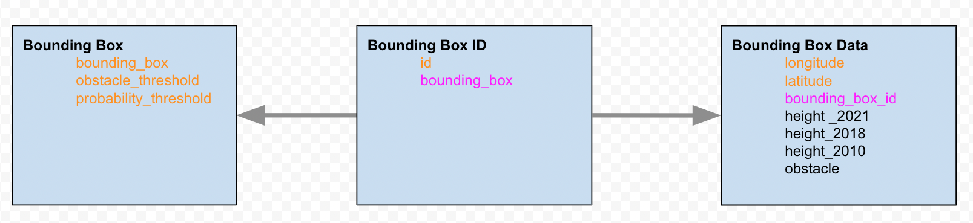
PostgreSQL Database Structure
Google Cloud PostgreSQL Database
Goal: Avoid Vertical Replication of Strings
Primary Key
Foreign Key

Slide 26
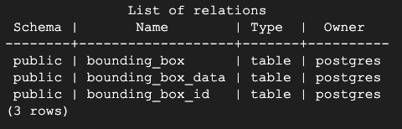
PostgreSQL Database Table Names

Slide 27

PostgreSQL Database: bounding_box Table
All three of these values in the bounding_box, obstacle_threshold, and probability_threshold columns must be unique
The bounding box is being stored as string for now
- Could potentiality change the structure and store xmin, ymin, xmax, and ymax individually as well

Slide 28

PostgreSQL Database: bounding_box_id Table
To avoid vertical replication of long string values in our tables, we can assign a bounding box id to each bounding box
In this way, the column that keeps track of which bounding box the cells are associated with only has to return an short integer value rather than a long string 459,886 times

Slide 29
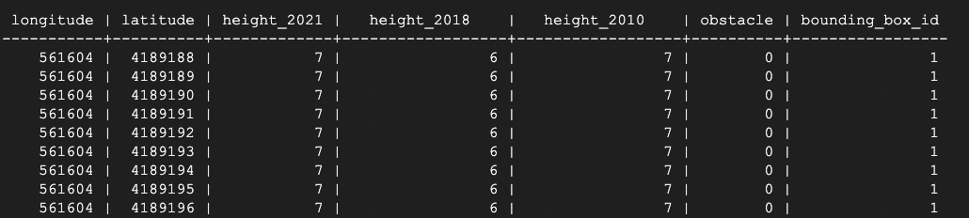
PostgreSQL Database: bounding_box_data Table
This table stores longitude, latitude, cross-validated height data, whether that specific cell contains an obstacle, and the bounding box id number
In this table, the columns longitude and latitude both serve as primary keys because each cell has a unique combination of these elements

Slide 30

Tech Stack
Python | Libraries pandasql pandas
RStudio | Libraries brms ggplot2 igraph RPostgreSQL
PostgreSQL | Google Cloud SQL Database

Slide 31
Potential Future Work
Addressing limitations to the approach that was taken in this report
When the raw point cloud data was extracted from the .ply files to create a dataset containing the height values for each cell in the years 2021, 2018 and 2010 respectively, instances of null values were plentiful
To remedy this, an interpolation technique was used to impute values into the dataset based on neighboring values
While this removed the null values, imputing values risks corrupting the underlying data
Another limitation that presents itself is the scalability of the model itself
This model was run on a plot of land that was 749 by 614 meters, an extremely small-scale application of Bayesian Regression
In order to apply this model to the entire continental United States, we would need magnitudes more computing power

Slide 32
Potential Future Work
The concept of cross-validation using LIDAR heights from multiple years is also in jeopardy when applied to a scale as large as the continental United States
There simply may not be enough overlapping LIDAR data in certain remote parts of the country to use cross-validation in combination with a Bayesian Regression model for an obstacle detection use case
In addition, the current PostgresSQL database design doesn’t support the usage
Another possible approach may be to create Bayesian priors for each individual cells probability distribution by creating a "confidence score" through a similar type of cross-validation
Optimize and automate drone obstacle avoidance database to store the outputs of Bayesian Regression
Standardize coordinates to allow querying based on geographical data, utilize PostGIS to calculate distances between points
Go to website, user queries based on geographic bounding box, obstacle height threshold, and acceptable probability threshold
Access OpenTopography’s API and request overlapping datasets, scripts would be run automatically based on user inputs and upload the results to the cloud PostgreSQL database a user can then access
Despite the current limitations, the future work described can help move the project further towards our goal of creating a communal store of quality data able to be utilized for aviation safety and help this emerging technology reach maturation

Slide 33
Thank you!

